Slide 1
Windows 7
Jón Harry Óskarsson
Presales Architect
Microsoft Íslandi
Harry.oskarsson@microsoft.com

Slide 2
Session Objectives
Session Objective(s)
Design Philosophy
Identify options and infrastructure requirements around Windows 7 networking features
Define a work anywhere infrastructure for a remote workforce with appropriate security
User interface enhancements
Key Takeaways
Windows 7 provides solutions for the evolving needs of a mobile workforce
DirectAccess deployment requires a phased approach involving strategy, infrastructure readiness, and rollout
BranchCache deployment requires a phased approach involving strategy, infrastructure deployment, and client configuration

Slide 3
The Making of
Listen & Learn
Quality & Fundamentals
Enable IT Pros & Developers
Excite End-Users
PLANNING
PREDICTABILITY
ECOSYSTEM

Slide 4
Windows 7 for the Enterprise
Make Users Productive Anywhere
Enhance Security & Control
Streamline PC Management
At their desk
In a branch
On the road
Protect data & PCs
Built on Windows Vista foundation
Easy migration
Keep PCs running
Virtualization

Slide 5
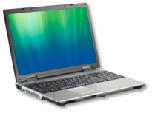
How can Uers be Productive Anywhere?
End-Users
IT
Hard for remote users to connect to resources
Hard to find information across PCs & data portals
Hard to ensure secure connectivity for remote users
Hard for you to manage mobile PCs and keep them up-to date
Hard for you to provide and manage access to information
DirectAccess
BranchCache™
Search Federation
Office
Home

Slide 6
Information Worker’s World Has Been Changing
CENTRAL OFFICE
REMOTE WORK
BRANCH OFFICES
MOBILE & DISTRIBUTED WORKFORCE

Slide 7
Windows 7 Addressing Enterprise Needs
Supporting IT Professionals
Addressing User Needs
Secure & Flexible Infrastructure
DirectAccess
VPN Reconnect & Mobile Broadband
DNS Security
Reduce Costs
BranchCache™ & SMB Enhancements
URL based QoS
Support for Green IT
Work Anywhere Infrastructure
DirectAccess
VPN Reconnect
Mobile Broadband
Fast Access
BranchCache™
SMB Enhancements

Slide 8
DirectAccess

Slide 9
Trustworthy Networking Vision
Internet
Remote Client
Enterprise Network
Identity: Strong authentication required for all users
Authorization: Machine health is validated or remediated before allowing network access
Local Client
Datacenter Servers
Protection: All network transactions are authenticated and encrypted
Policies are based on identity, not on location

Slide 10
DirectAccess: More than Remote Access
Always On
Manage Out
Access Policies
Protected Transactions
Improved productivity
"Light up" remote clients
Pre-logon health checks and remediation
Supports authenticated transactions
Not user initiated
Decreases patch miss rates
Replaces modal "connect-time" health checks
Supports encrypted transactions
Simplified connectivity
Applies GPOs to remote computers
Full NAP integration
Authentication and encryption mitigate many attacks
VPNs connect the user to the network
DirectAccess extends the network to the computer and user
Notes:
10/20/2009 8:49 PM
©2004 Microsoft Corporation. All rights reserved.
This presentation is for informational purposes only. Microsoft makes no warranties, express or implied, in this summary.
10

Slide 11
The Evidence
DirectAccess with Windows Server 2008 R2 and Windows 7 Operating System
“Recently, a sales account executive and I had about an hour-long drive back to the office from a customer site. With DirectAccess, he was able to log on to our network, access the documents he needed, and write the proposal while I drove. By the time we got back to the office, he was already hitting the send button to deliver the proposal.”
Rand Morimoto, President, Convergent Computing

Slide 12
DirectAccess: Technical Foundation
Name Resolution: DNS and NRPT
Data Protection: IPsec
Connectivity: IPv6

Slide 13
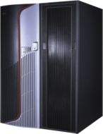
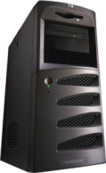
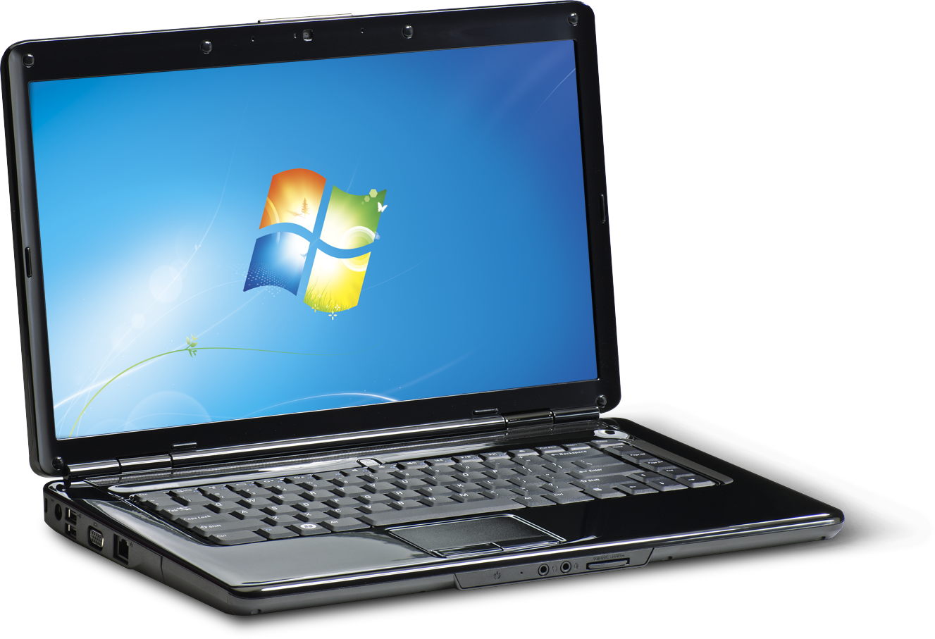
Connectivity: IPv6
IPv6 Options
DirectAccess requires IPv6
If native IPv6 isn't available, remote clients use IPv6 transition technologies
The corporate network can deploy native IPv6, transition technologies, or NAT-PT
DirectAccess works best if the corporate network has native IPv6 deployed
Internet
Intranet
NAT-PT
Native IPv6
IPv6 Transition Technologies
IPv4

Slide 14
Data Protection: IPsec
IPsec
Authentication
Encryption
End to edge
End to end
End to edge
End to end
IPsec tightly integrates with IPv6, allowing rules engine to determine when and how traffic should be protected

Slide 15
Name Resolution: DNS and the NRPT
DirectAccess Connection
Internet Connection
Remote DirectAccess clients use smart routing
for DNS queries by default
The Name Resolution Policy Table (NRPT) allows this to happen efficiently
DirectAccess sends name queries to intranet DNS servers based on pre-configured namespace

Slide 16
Name Resolution Policy Table (NRPT)
Pertains to the client side only
Uses a static table to define which DNS servers will be used by the client for the listed names
Is configurable via Group Policy Objects (GPO) at Computer Configuration/ Windows Settings/Name Resolution Policy
Can be viewed with netsh name show policy
NRPT
.ad.contoso.com | 2001:db8:b90a:c7d8::178 2001:db8:b90a:c7d8::183
.lab.contoso.com | 2001:db8:b90a:c7a8::202
.nls.contoso.com | 2001:db8:b90a:c7e4::801

Slide 17
IPsec Tunnel Detail
Tunnel 1: Infrastructure Tunnel
Authentication: Computer Certificate + NTLM
Client Access: AD/DNS/Management
Tunnel 2: Intranet Tunnel
Authentication: Computer Certificate + User Kerberos
Client Access: Other available resources
DirectAccess Client
DirectAccess Server

Slide 18
Requirements for DirectAccess
Customer Knowledge
Should have a basic working knowledge of IPsec or TCP/IP
Should be interested in learning and deploying new technologies, such as IPv6
DirectAccess Clients
Windows 7 Enterprise Edition or Windows 7 Ultimate Edition
Domain-joined computers
DirectAccess Server
Windows Server 2008 R2, Standard Edition or Higher
Domain-joined computers
Others
DNS Servers Supporting DirectAccess Clients - Windows Server 2008 SP2 or later
A public key infrastructure (PKI) to issue computer certificates, smart card certificates, and, for NAP, health certificates.

Slide 19
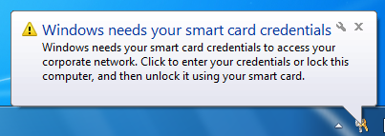
Multi Factor Credentials for Intranet Access
Two Factor Authentication (TFA) is fully supported but not required
Edge-based enforcement is a smarter way to enforce TFA
Users are assigned a well-known SID when they log on with a smartcard (S-1-5-65-)
Users may log on to a laptop without TFA
When users access corporate resources, the IPsec authorization policy checks for the SID…

Slide 20
Direct Access Deployment
Deployment Strategy
Prepare to monitor IPv6 traffic
Choose an access model (e.g., full intranet access vs. selected server access)
Determine deployment scale
Deployment Process
Prepare infrastructure
Configure DirectAccess server
Customize policies, as needed

Slide 21
BranchCache™

Slide 22
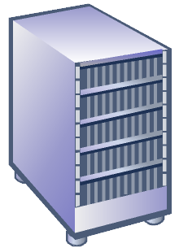
Problem Background
Thin, expensive WAN links between
main office and branch offices
High link utilization
Poor application responsiveness
Trend towards data centralization

Slide 23
New in Win7 and WS08R2
Introducing
BranchCache™
Reduce bandwidth utilization
Improve end user experience
Preserve e2e security
Simple to deploy

Slide 24
Solution Overview
Retrieve content from within the branch when available
Distributed: From other clients in the branch
Centralized: From a “hosted cache”
Client can only retrieve content locally if authorized by the server
Used by HTTP, HTTPS, SMB, BITS
Transparent to client and server applications building on it

Slide 25
BranchCache Deployment
Get ready step by step
Select a deployment strategy
Deploy infrastructure
Configure the clients

Slide 26
1. Select a Deployment Strategy
Enterprise
Distributed Cache
Hosted Cache
Distributed Cache
Data cached amongst clients
Data cached at the host server

Slide 27
Distributed Cache
Main Office
ID
Get
Data
ID
Data
Get
Branch Office
Get
Get
Data

Slide 28
Hosted Cache
Main Office
Get
ID
Data
Data
ID
Get
ID
Search
Get
Get
Search
ID
Data
Offer
ID
Request
ID
Data
Put
Branch Office

Slide 29
Distributed vs Hosted Cache
Enterprise
Distributed Cache
Hosted Cache
Distributed Cache
Data cached amongst clients
Data cached at the host server
Recommended for branches without any infrastructure
Easy to deploy: Enabled on clients through Group Policy
Cache availability decreases with laptops that go offline
Recommended for larger branches
Cache stored centrally: can use existing server in the branch
Cache availability is high
Enables branch-wide caching

Slide 30
2. Deploy the Infrastructure
Hosted
Cache
Install BranchCache™ feature on an R2 content server
Branch Office
Optionally, install an R2 Hosted Cache in your branch.
IIS
File Server
Group Policy
Management
Main Office

Slide 31
3. Deploy Your Clients Distributed Mode
Identify the “branch”
An Active Directory Site
Choose how to deploy
Group Policy
netsh
Deploy to clients!
Group policy: Use built-in ADMX files
netsh: Run netsh branchcache set service distributed on all relevant clients
An IP address range
A collection of specific client computers
Branch Office

Slide 32
3. Deploy Your Clients Hosted Cache Mode
Setup the hosted cache
Choose how to deploy
Deploy to clients!
Group policy: Use built-in ADMX files
netsh: Run netsh branchcache set service hostedclient location=<> on all clients
Run netsh branchcache set service hostedserver on the hosted cache
Install the BranchCache feature on an R2 server
Install a server-auth certificate for use with SSL
Identify Branch

Slide 33
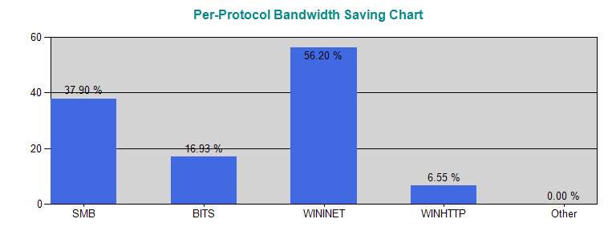
Aggregate Bandwidth Report
Total Data Traffic Per Protocol
 | Bytes From Cache | Bytes From Server |  | Total Bytes Transmitted |  | Bandwidth Saving (%)
BITS | 16,965,928 | 83,239,376 |  | 100,205,304 |  | 16.93 %
Other | 0 | 0 |  | 0 |  | 0.00 %
SMB | 10,395,103,851 | 17,035,293,799 |  | 27,430,397,650 |  | 37.90 %
WINHTTP | 3,729,408 | 53,224,647 |  | 56,954,055 |  | 6.55 %
WININET | 520,721,713 | 405,857,305 |  | 926,579,018 |  | 56.20 %
Total | 10,936,520,900 |  | 17,577,615,127 |  | 28,514,136,027 |  | 38.355%

Slide 34
Summary
Windows 7 provides solutions for the evolving needs of a mobile workforce
DirectAccess deployment requires a phased approach involving
Strategy
Infrastructure readiness
Rollout
BranchCache deployment requires a phased approach involving
Strategy
Infrastructure deployment
Client configuration

Slide 35
© 2009 Microsoft Corporation. All rights reserved. Microsoft, Windows, Windows Vista and other product names are or may be registered trademarks and/or trademarks in the U.S. and/or other countries.
The information herein is for informational purposes only and represents the current view of Microsoft Corporation as of the date of this presentation. Because Microsoft must respond to changing market conditions, it should not be interpreted to be a commitment on the part of Microsoft, and Microsoft cannot guarantee the accuracy of any information provided after the date of this presentation. MICROSOFT MAKES NO WARRANTIES, EXPRESS, IMPLIED OR STATUTORY, AS TO THE INFORMATION IN THIS PRESENTATION.

