Slide 1
From prescription to administration of chemotherapies:
Use of GS1 standards for supporting global traceability
EFMI STC 2010
Reykjavík, June 2-4
Stéphane Spahni
Clinical Informatics Unit
Medical Informatics Service
University Hospitals of Geneva

Slide 2
Context
Critical treatments
Dangerous products
Severe consequences in case of error or misuse
High costs of products, often low usability duration
Need for securing the whole process – from the prescription to the administration
  Protocol driven prescription in the CPOE
  Protocol driven production in the pharmacy
  Avoidance of manual work at all places:
    prescription, production, administration
  Traceability of products and actions

Slide 3
Phases
Prescription
  Prescription of a protocol = set of medications, with specific dosages and calendar of administration
Reception by the central pharmacy
  One or several medications taken in charge at a time
  Preparation of the everything required for the fabrication
Fabrication of the specific medication
  Combination of the ingredients for producing the specific medication for a specific patient
  Global traceability at the pharmacy of what was produced, when, how, by whom
Administration of the medication to the patient

Slide 4
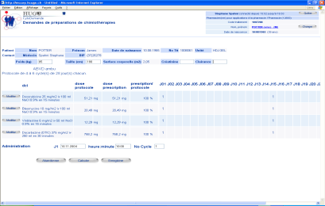

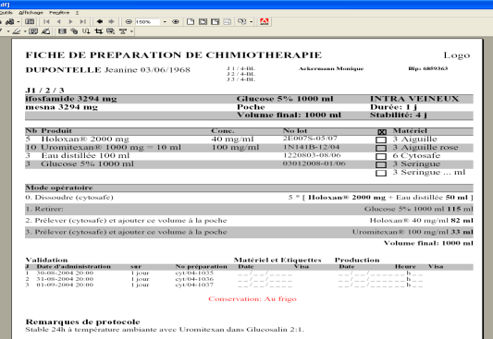
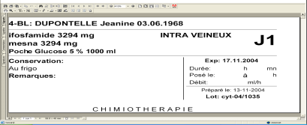

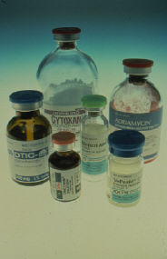
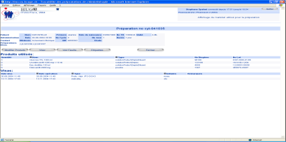

Global workflow
Prescription
Set of medications
with recipes
HIS
Final product
Ingredients
Traceability &
quality control
Manufacturing

Slide 5
Two interesting phases
At the pharmacy:
  Registration of what is being selected for the fabrication (“ingredients”, material)
  Registration of what is being really used for the fabrication
At the bed side:
  Validation of what is being administered to who, when and by whom
  Registration of the different phases (start, stop, …)

Slide 6
Traceability at the pharmacy
Several steps performed by different persons:
Preparation of the set of ingredients to be used:
  Identification of the true vials (product, batch number)
  Identification of the manufacturing kit
Manufacturing of the final product:
  Identification of the substances at each step of the preparation
  Identification of the batch numbers at each step of the preparation
Quality control & traceability of what has been used, when and for which final product
Identification of each final product with a unique ID

Slide 7
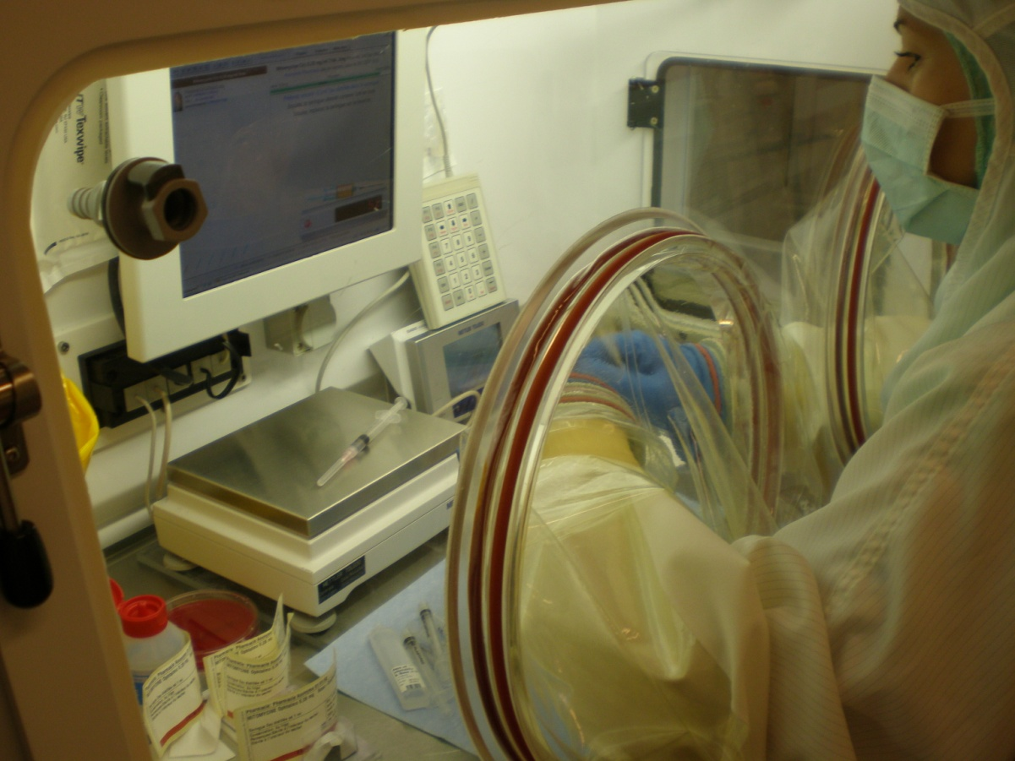
Manufacturing
Very limited space
Screen + keypad at the rear for interacting with the system
Automated and connected balances for validating quantities and volumes
Scanner for identifying vials & material

Slide 8
Traceability at bed level
Identification of the care giver (= by whom)
Identification of the medication (= what)
Identification of the patient (= for whom)
Validation of the time (= when) and of the path and the duration (= how)
Recording of various events – start, stop, check, pause, cancellation
For whom x What x By whom x When x How = OK ?

Slide 9
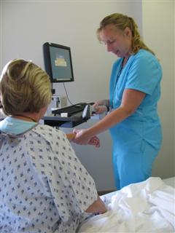
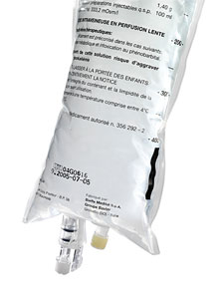

Administration of the medication
Care giver identified through his/her login
Scanning of the patient’s wristband
Scanning of the medication’s label
Complementary information given through application’s UI

Slide 10
What kind of unique Ids ?
Unique IDs for various types of « objects »:
  Medications, Vials of raw products, other material
  Persons (patients)
  Documents (prescription, …)
Selection of the GS1 Standard:
  GTIN for products & vials (unique ID, batch number)
  GTIN for locally produced medications (serial number, expiry date)
  GSRN for patients
  GDTI for documents
Datamatrix representation as the vehicle for the ID

Slide 11

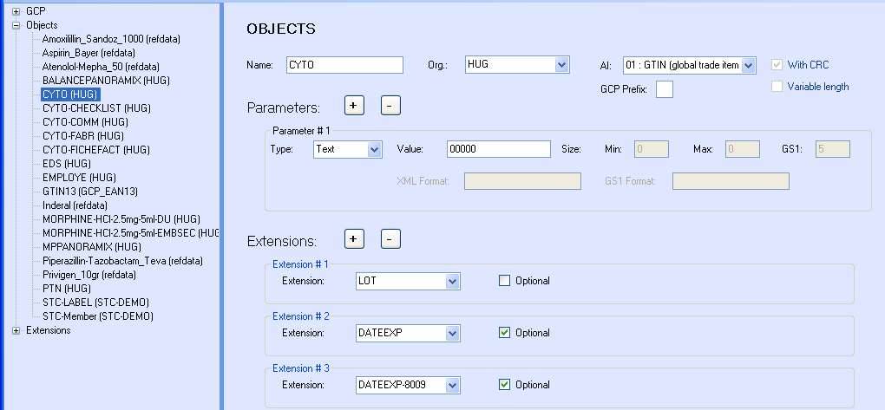
GS1 codes: Cytostatic production
Application: <CYTO>
<org>HUG</org>
<LOT>cyt-10106123</LOT>
<DATEEXP>2010.06.07 12:30:00</DATEEXP>
</CYTO>
GS1: (01)07613167000009(7003)1006071230(21)cyt-10106123

Slide 12
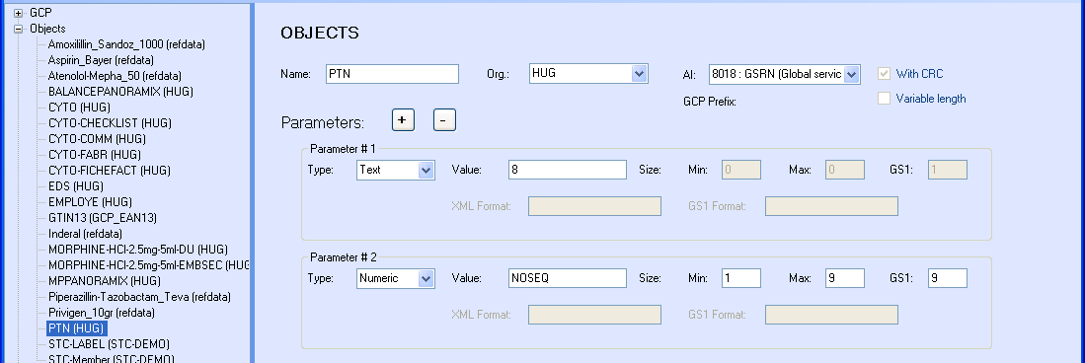
GS1 codes: Patient ID
Application: <PTN>
<org>HUG</org>
<NOSEQ>000123456</NOSEQ>
</PTN>
GS1: (8018)761316780001234564

Slide 13
Conclusion (1)
GS1 standard proved to be adequate for the selected objects to identify
HUG GS1 codes for objects « belonging » to HUG:
  Manufactured medications
  Patients
  Documents produced by the clinical information system
Lack of usable codes on vials
  Not all vials and material with unique ID (product + batch number)
  Temporary solution by re-encoding vials

Slide 14
Conclusion (2)
Centralized management of codes (encoding, decoding)
  Semantic & Rules at ONE single place
  Easy to manage, maintain, modify, enhance
  Temporary: (01)07613167000009(8009)1006071230(21)cyt-10106123
  Final: (01)07613167000009(7003)1006071230(21)cyt-10106123
GS1 codes = envelope on existing codes
  GS1 adds the semantic meaning to existing identifiers
  No re-invention of identification codes

