Slide 1
Meeting EHR Security Requirements:
SeAAS Approach
Basel Katt ,Thomas Trojer, Ruth Breu
University of Innsbruck, Austria
Thomas Schabetsberger, and Florian Wozak
ITH icoserve/Siemens, Austria

Slide 2
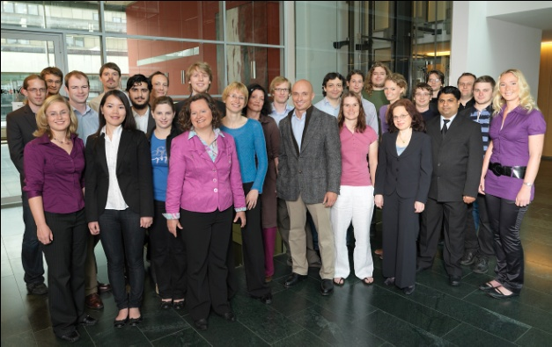







Quality Engineering
Selected Projects

Slide 3






Quality Engineering Laura Bassi Lab
Living Models for Cooperative Systems
Industry Partners

Slide 4
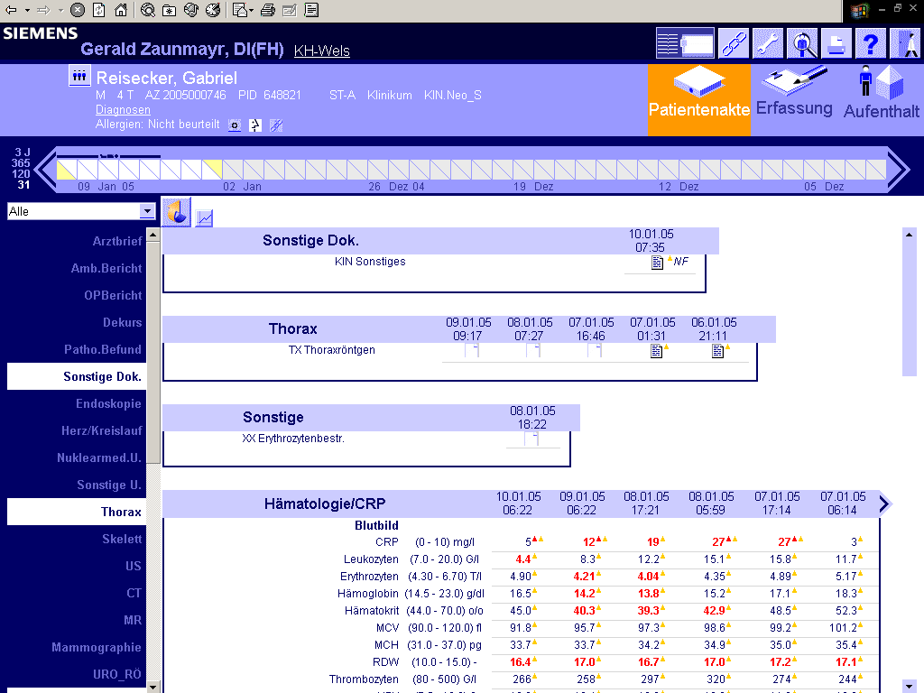
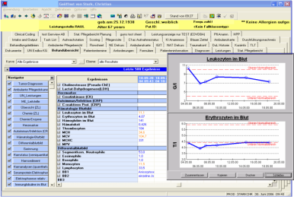
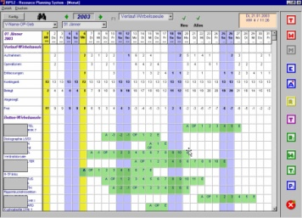

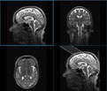





ITH icoserve Portfolio /1
Clinical
Information
Systems
DICOM
(PACS)
Multimedia
Digital
Archives
local
node
comm
unity
node
Portals
registries
ELGA

Slide 5


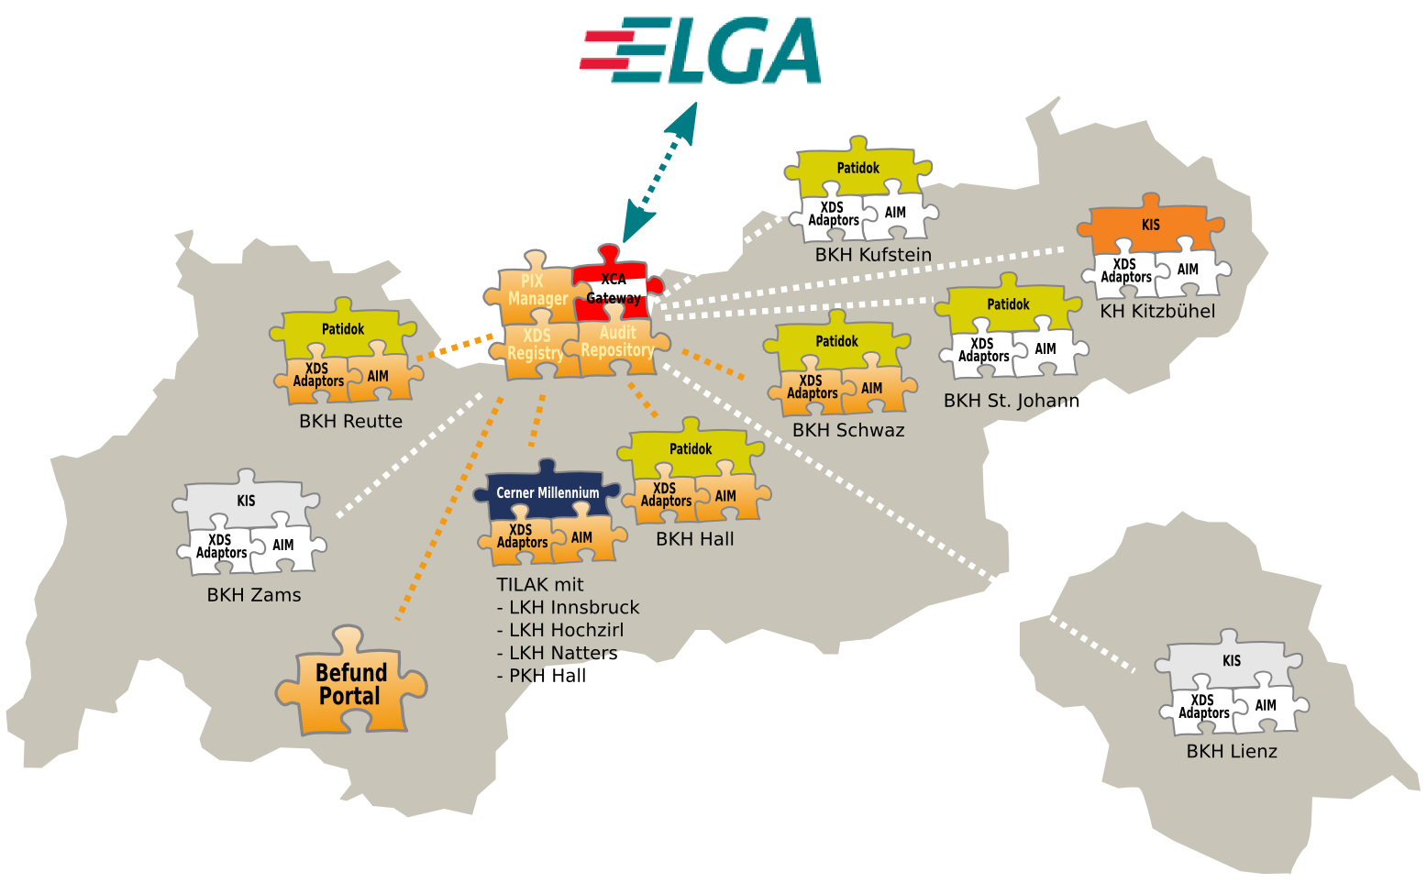
ITH icoserve Portfolio /2
Health Network Tyrol

Slide 6
Challenges related to Security Architecture
IHE (Integrated Healthcare Enterprise) Initiative
  proposes different profiles supporting the development of distributed Electronic Health Records (EHR)
IHE Security profiles have two main drawbacks
  Application of end point security paradigm
  security profiles for complex security requirements like privacy and non-repudiation are vague and do not consider architectural design
End point security in distributed and heterogeneous EHR systems
  increased management and maintenance overhead
  increased processing overhead at each end point
Challenging enforcement of complex security requirements at each point

Slide 7
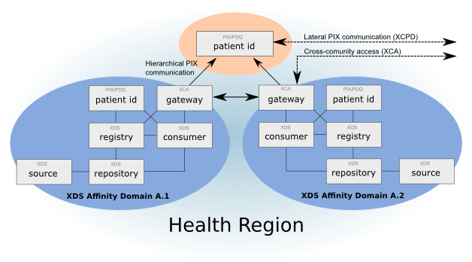
IHE Basic Reference Architecture
Health Region is divided into affinity domains
  Registry/Repository and Source/Consumer based on XDS profiles
  Patient id for local identification based on PIX/PDQ profiles
  Gateways as a bridge between different domain based on XCA profile
Global Patient Id component

Slide 8
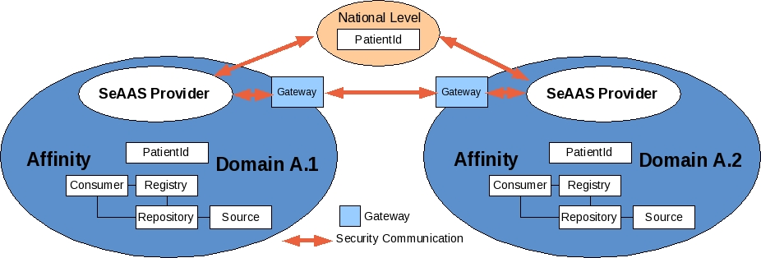
Architectural Solution – Security as a Service
Extracting security functionalities from end points
  Security tasks and mechanisms are moved from end points and placed in security specific components
  These components are responsible for all security requirements of the whole domain

Slide 9
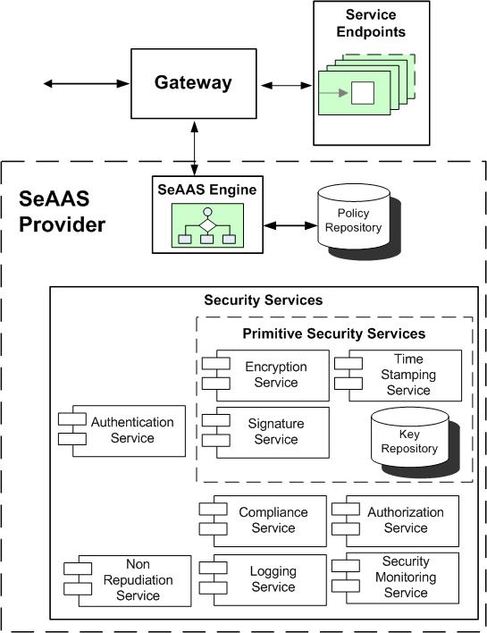
SeAAS Provider Architecture
Main Components
  SeAAS Gateway
    intercepts functional requests
    and queries the SeAAS provider
  SeAAS Provider
    Engine to orchestrate the
    functions of different services
    Configuration by Policy Repository
    Security Services
      Primitive Services
      Complex Services

Slide 10
Benefits
Compatibility with current IHE security profiles
  Proposed extension and new profiles based on SaaS paradigm
Centralized Security Solutions
  Overcoming the management and maintenance complexity
  Reducing the processing overhead of end points
Tackling advanced security requirements like non-repudiation, privacy and complex access control policies

Slide 11
Conclusion
IHE profiles as a basis for the realization of distributed EHR systems
Problems of security related profiles
  No support of complex security requirements
  End point security paradigm
Security as a Service Architecture (SeAAS)
  Based on the cloud paradigm
  Conforms with the current IHE profiles and proposes possible extensions
Ongoing Work
  Performance evaluation of the SeAAS architecture
  Enabling patients to set access rights to health data
  Usability evaluation
  Integration with continuous security management to monitor security requirements

