Slide 1
Risk assessment of integrated Electronic Health Records
EFMI STC 2010 – 3 June 2010
Gudlaug Sigurdardottir
Bjarni Thor Bjornsson
Notes:
Introducing authors of paper:
Gudlaug Sigurdardottir, Director of SW Development at Stiki
Bjarni Thor Bjornsson, CTO of Stiki
Stiki is a privately owned company.
Stiki develops and provides specialized software and contultancy in the area of information security and risk managment.
Stiki also develops custom made software in the field of health care and hosts systems providing electronic health records.

Slide 2
Introduction
Electronic Health Record (EHR) systems and network must fulfill demands of modern society
New legislation in Iceland allows sharing of health information between institutions
Security must be guaranteed
Security requirements and risk assessment
Notes:
Electronic Health Record systems and network must fulfil todays requirements of seamless care and interoperability which is a demand of modern society.
This fact may have led to the new legislation that the government of Iceland passed in April 2009, allowing sharing of health information.
Sharing of such a sensitive information calls for guaranteed security.
In our paper we discuss security requirements and go through some demonstration on how to perform risk assessment.

Slide 3
Legislative requirements
Opens the door for information sharing between health information systems
Results in a better and more secure public health care service since information is available when required on a need-to-know basis
Security guarantees and adherence to the Personal Data Act legislation are prerequisites for information sharing and integration of systems
Allows for public access to EHR information through health information gateways

Slide 4
Future Vision
Greater interaction between different EHR systems
Interoperable EHRs will appear as a unified view of all health care data
Health care professionals will have all the necessary data available when needed
The public will be able to monitor their EHRs directly via Internet access
Notes:
The summarized future vision of the EHR:
To have increased interaction between the various, distributed EHR systems
EHRs are interoperable but will appear as a unified view of all health care data
Health care professionals will have access to all necessary data available where and when needed.
The public will also be able to monitor their own health records directly via internet access.

Slide 5
EHR integration and users
Electronic Health Record keepers
Community Health Centers
Hospitals
Private
Practices
Internetwork
Governmental Authorities
Other health care providers
The Directorate of Health
Access control DB
Health care
professionals
Supervisory
authorities
Public
access
Notes:
Here we have a schematic picture of the visioned EHR system.
It is distributed, where we have various health record keeper and providers.
The record keepers include hospitals, community health center, private practices, governmental authorities, etc.
The access to the system is controlled and health care professionals, auditing/supervising authorities and the public will have controlled access on a need-to-know basis.

Slide 6
EHR related security issues
Highly critical, personal and sensitive information
Falls under the act and regulations on the protection and processing of personal data
Great demand on having EHRs easily accessible for health care providers
Privacy concerns need to be addressed with adequate controls to minimize risk of misuse and accidental disclosure
Information can be categorized and access restriction imposed on a system-by-system or even record-by-record basis
Notes:
If we look at some security issues:
We have highly critical, personal and sensitive information which falls under the act and regulations on the protection and processing of personal data.
There is a great and increasing demand on having health records easily accessible for health care providers
There are naturally some privacy concerns regarding misuse and accidental disclosure. These concerns must be addressed with implementation of adequate controls to minimize the risk
Imposed access control is complex where information is to be categorized and access restrictions can be on a system-by-system or even record-by-record basis.

Slide 7
Risk management methodology
Important to use a standardized, systematic method
The ISO/IEC 27005:2008 guidelines for information security risk management provides a standardized methodology
Takes into account all aspects of the risk assessment requirements of the ISO/IEC 27001 security standard
Notes:
This leads us to risk management and the importance of performing risk assessment.
Not only is it required by the Personal Data Act legislation but also it gives a good overview of all risk factors and leads to better security awareness.

Slide 8
Risk assessment – step by step
In scope
Out of scope
Out of scope
Out of scope
Out of scope
boundaries
Define the scope and criteria
Identify assets and their value
Identify and evaluate threats
Evaluate and manage risk – risk treatment
Plan
Act
Do
Check
Risk assessment
Implement risk treatment plan
Continual monitoring and reviewing of risk
Maintain and improve
Notes:
Plan
Establishing the context
Risk assessment
Developing risk treatment plan
Risk acceptance
Do
Implementation of risk treatment plan
Check
Continual monitoring and reviewing of risks
Act
Maintain and improve the Information Security Risk Management Process

Slide 9
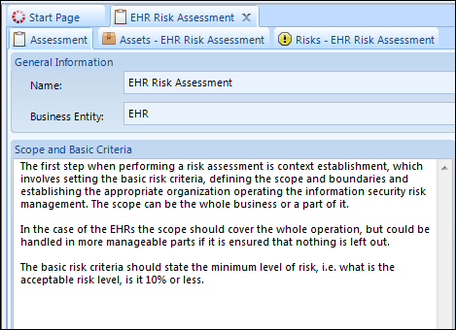
Define scope and criteria
Identify in-scope systems, services, procedures etc.
Define boundaries
Risk criteria,
level of acceptable risk
Scope and Criteria

Slide 10
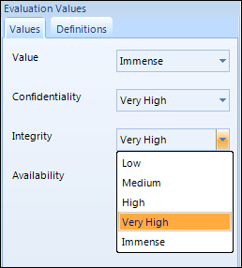
Identify assets and their value
Identify assets
Identify owner of assets
Evaluate asset value
Evaluate CIA value
Notes:
Assets can be tangible such as Computer servers, buildings etc, or non-tangible such as data (EHR data), procedures, contract or even reputation and image.
Anything of value to the Electronic Health Record and its defined usage and operation.
The three core principles of information security:
Confidentiality : Only authorized parties should have access to the information
Integrity: Authorized parties should be asured of the correctness of the information
Availability: Authorized parties should have access to the information when needed
Timely available and correct information can literally mean the difference between life and death

Slide 11
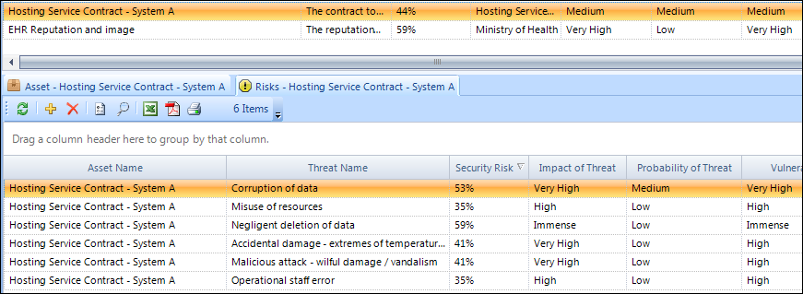
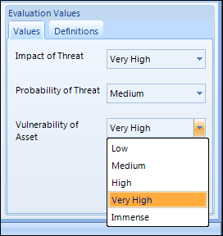
Identify and evaluate threats
Identify all threats per asset
Probability of threat
Evaluate each threat
Impact of threat
Vulnerability of the asset
Notes:
Identifying threats
For each asset it is necessary to identify all threats, threatening each asset

Slide 12
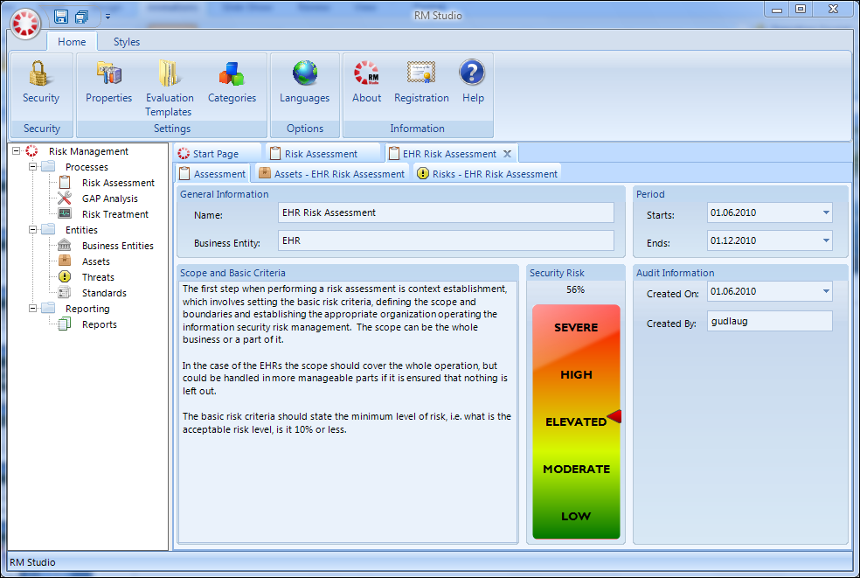
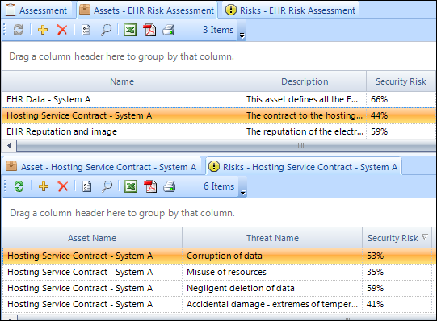
Outcome of risk assessment
Base security
And to the individual risk
For the business entity
Down to each asset
Notes:
Once assets and threats have been identified and evaluated the risk assessment has been completed.
The outcome is an overview of all potential risks and a calculated risk value based on the evaluations.
So here we have our base security risk
For the business entity or the “in-scope” operation
Down to each asset
And to the individual risk, which makes it possible to order and prioritize actions based on the risk value.

Slide 13
Risk treatment process
Risk evaluation
1. Select risk treatment option
Risk communication
2. Define the risk treatment plan
3. Calculation of the residual risk
Risk monitoring and review
4. Acceptance of residual risk
Notes:
Then we come to the risk treatment process. What is our plan to treat the risk.
The possible actions include reducing risk by implementing appropriate controls, knowingly and objectively accepting risk providing they clearly satisfy the policy and criteria for accepting risks, avoiding risk and transferring risks to other parties such as insurers.
The risk treatment options should be chosen based on results of risk assessment, cost of implementation and expected benefits of these options.
When risk reductions can be achieved with relatively low costs and can be justified by an acceptable return on investment, these options should be implemented.
The four options for risk treatment are not mutually exclusive. Sometimes the company can benefit substantially from a combination of options.

Slide 14
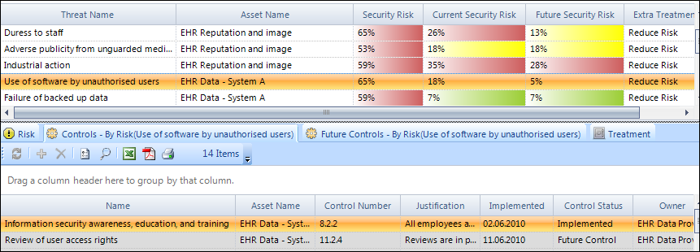
Reducing risk
Select and implement controls to reduce risk
Not Implemented
Future Control
Partially Implemented
Implemented
Not Applicable

Slide 15
Risk acceptance – Security awareness
After completing the risk treatment it is important to obtain management approval of the proposed residual risk
Risk communication, monitoring and reviewing of risk is important for the security awareness and for continuous improvements in risk management
Plan
Act
Do
Check
Risk assessment
Implement risk treatment plan
Continual monitoring and reviewing of risk
Maintain and improve

Slide 16
Conclusion
EHR integration, increased interoperability and access are important steps in advancing the state of health care services
By applying best practices, using an information security management system, performing regular risk assessments, and adhering to international standards, these steps can be safely realized
The result will be a better and more secure health care system for the benefit of the public

Slide 17
Thank you
gudlaug@stiki.eu
bjarni@stiki.eu
www.stiki.eu
All screenshots in presentation are from RM Studio, a risk management software provided by Stiki
www.riskmanagementstudio.com

