Slide 1
Seamless Care: What is it; what is its value; what does it require; when might we get it?
W. Ed Hammond. Ph.D., FACMI, FAIMBE Director, Duke Center for Health Informatics Professor , Department of Community and Family Medicine Professor, Department of Biomedical Engineering Adjunct Professor, Fuqua School of Business Duke University
Vice-chair, Health Level Seven

Slide 2
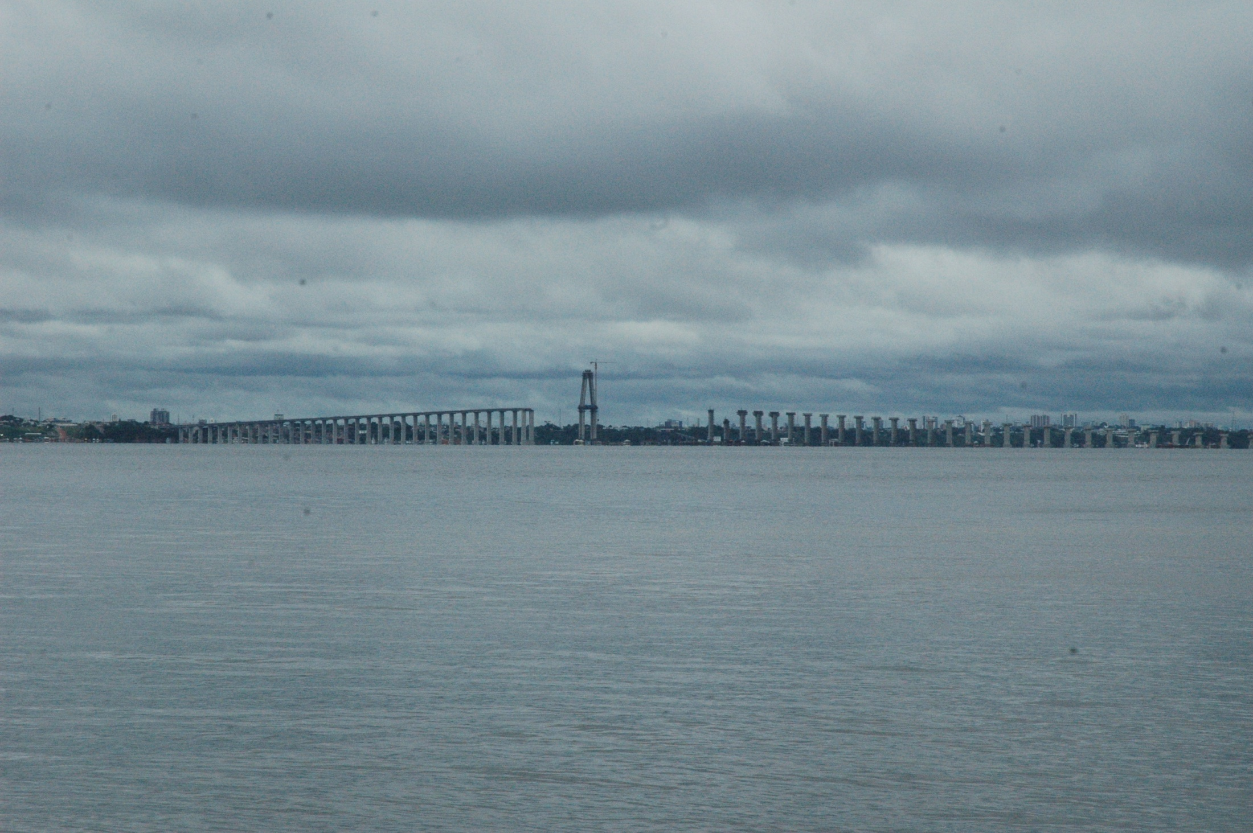
Some progress
Research Funding
Interoperability Gap
Siloed Efforts

Slide 3
Seamless care
Seamless - perfectively consistent and coherent, marked by an orderly, logically and aesthetically consistent relation of parts; perfect, flawless, without discontinuities or disparities; uniform in quality; and combined in an inconspicuous way.
Key objectives are continuity of care and multiple related uses of healthcare data.
Notes:
Notice what it doesn’t include: same or identical; we can still have variation

Slide 4
Today’s healthcare environment
Includes an ill-defined set of entities: people, locations, demographics, diseases, treatments, tests, devices, data elements, requirements, rules and regulations, policies, purposes, governances, models, and more.
A seamless care environment must bring all of these parts together in an orderly, logical and aesthetically consistent way.

Slide 5
Today’s healthcare delivery system
Care is delivered today in a disconnected way in hospitals, clinics, doctor’s offices, nursing homes, extended care facilities and patient’s homes.
Today’s systems are fragmented; inefficient, and too frequently almost non-functional. We make errors; we make decisions without adequate data or appropriate knowledge; we don’t know what outcomes result from our interventions.
Seamless care is the opposite of what we have today.

Slide 6
What is seamless care?
How bold is your vision?
Global seamless care would require the most massive effort in human history?
Subject to privacy constraints, I can access the EHR of any person in the world when appropriate, and understand the content and meaning of the data.
My healthcare data is available, when appropriate, anywhere in the world, with full understanding of its meaning and use.

Slide 7
What is seamless care?
All data generated about a patient, regardless of place or site of care, is aggregated into a single real or virtual EHR – that is what patient-centric means.
Enables personalized care
It is woven from threads from all communities, all stakeholders, all uses, and all purposes.
It shares a common vision.
It builds on a network of connectivity that enables the EHR.

Slide 8
What is seamless care?
It provides trust and integrity for all data across all sources.
It includes data on a patient’s demographics, health status, treatment, and outcomes.
It integrates knowledge with data into the workflow to provide cognitive support for clinicians and patients.
Seamless care starts at the beginning of the planning process and governs throughout.

Slide 9
What is its value?
Eliminates siloed approach to health care, research, government grants, data reuse
Rich set of data available for research
Candidates for clinical trials
Any adverse event is discoverable
Outcomes available for any and all treatments
Enables the discovery of new knowledge
Evidence-based medicine becomes truly evidence-based.

Slide 10
What is its value?
Provides accurate population statistics that are detailed by demographic, social, geographical, and economical characteristics
Enables quick and effective response to natural disasters
Enables global health surveillance

Slide 11
What is its value?
U. S. stimulus funding is $19 billion, increased to $36.5 billion through HIT savings
U.K. spending approximately $19 billion
EU spending in billions of euros
Canada spending approaching $1 billion
Most funding among these countries is for the same things and are part of a seamless care environment.
Can we share development and avoid redundant development?

Slide 12
What does it require?
Can we create a seamless effort for a seamless healthcare environment?
Change, change, change
Common standards used globally
Consistency in process
Connectivity that is ubiquitous with no holes
What we do and what data we collect is dictated by evidence and need not by custom or habit
Participation by all stakeholders, particularly governments

Slide 13
What does it require?
Requires a level of collaboration and cooperation that does not exist today
Acceptance and acknowledgement of contributions from others; sharing
Working beyond our inherent competitive nature; moving from a national perspective to a world perspective
Requires an answer to what can I do with HIT that I cannot do without HIT.

Slide 14
Application of HIT
Understand the problem to be solved.
Understand causes, factors, issues
Understand measurements and data required to monitor & solve
Implement proposed solution.
Outcome
Evaluate outcome
Feedback Loop

Slide 15
What is required?
Are existing standards sufficient to achieve a seamless care environment?
Fundamental to achieving seamless care requires, in my opinion, a global, common set of data elements that include self-defining attributes

Slide 16
Data elements - attributes
OID that is universally persistent
Expert-based definition that is precise and unambiguous
May be translated into multiple languages
Includes, when appropriate, a computer-understandable definition that provides for verification and integrity check – is a component of knowledge

Slide 17
Data elements - attributes
Name set
Preferred name (long name)
Short name
Computer name
Synonyms
Repeating field, translated into all languages
Data class
Properties and characteristics

Slide 18
Data elements - attributes
Physical characteristics
Data type (simple)
Units
How measured
Value sets – master set of value choices for data element
Purpose of data element, why collected
Linkages and relationships to other elements

Slide 19
Data elements - attributes
Triggers
Message interchange
Reevaluate decision support
Report
Linkage
Administrative attributes
Steward
Status, versioning, authority, …

Slide 20
Interoperability for seamless care
We need to know whose data it is in order to aggregate data without error.
Requires unique person identifier
We need to know the meaning of data independent of source and context; supporting data will identify the context.
We need to know what data must be collected under what conditions, including when and how.
Requires a team concept for data collection

Slide 21
Interoperability for seamless care
We need to share data among multiple sites (transport), using intelligent filters and triggers to define what data is exchanged
We must be able to merge data from all sources in a reliable controlled and timely fashion without loss of information.
We must establish trust and integrity of the merged database, such that life and death decisions can be made.

Slide 22
Interoperability for seamless care
We must create and mine clinical data warehouses to obtain new knowledge to support evidence-based medicine.
We must incorporate decision support algorithms in workflow and data flow.
Clinical guidelines must be used to support an informed process of care, based on evidence. We must integrate new forms of data, such as images into the EHR.

Slide 23
Interoperability for seamless care
We must engage consumers into the health and healthcare process.
We must create a system that lets us locate any patient’s EHR from anywhere in the world.
We must adequately deal with security and privacy, finding the proper balance between appropriate use and privacy.
We must provide ubiquitous, global conductivity.
Notes:
Ust provide global connectivity.

Slide 24
Interoperability for seamless care
There must be a governance and infrastructure in place to control and manage the flow and use of data.
We must move from illness care to preventive care to personal care that includes an understanding of risk factors and pre-emptive care.
We must evaluate systems that include the value to the patient.

Slide 25
When an artist paints, his choice of canvas is:
A new, unused canvas on which he can paint any picture, or
A used canvas on which he can over-paint to produce any picture, or
He can have a used canvas on which he incorporates new with old.
Which shall we be?

Slide 26
When might we get it?
What do we do with legacy systems?
Who is the boss? What is governance?
Who is the architect?
Who makes the plan?
What is the process? Do we do country by country or region by region or globally?
Who pays for it?
Do we take halfway measures to get there?
How long will it take?

Slide 27
When might we get it?
Who has solved the problem and who is closest to the solution?
How do we sustain and maintain such a system?
What roles do the various stakeholders play?
How are decisions made?
How do we manage intellectual property?
How do we balance theoretical and real?
Who starts the process?

Slide 28
Might we get there?
What is the motivation for Europe, U.S., and Canada and the rest of the world to work together?
What is the motivation for the SDOs to work together?
What is the motivation for the stakeholders to work together?

Slide 29
Getting there
The art of the possible
Rethink possible

Slide 30
Conclusion
Technology is more than adequate.
Standards are workable – will at least permit a start.
We probably have a pretty good idea for how to do it.
We can afford it – for the world?
Will we do it?

Slide 31
Place your bets!
Moon shot
Landing on Mars
World hunger
Seamless care environment
World peace

