Slide 1
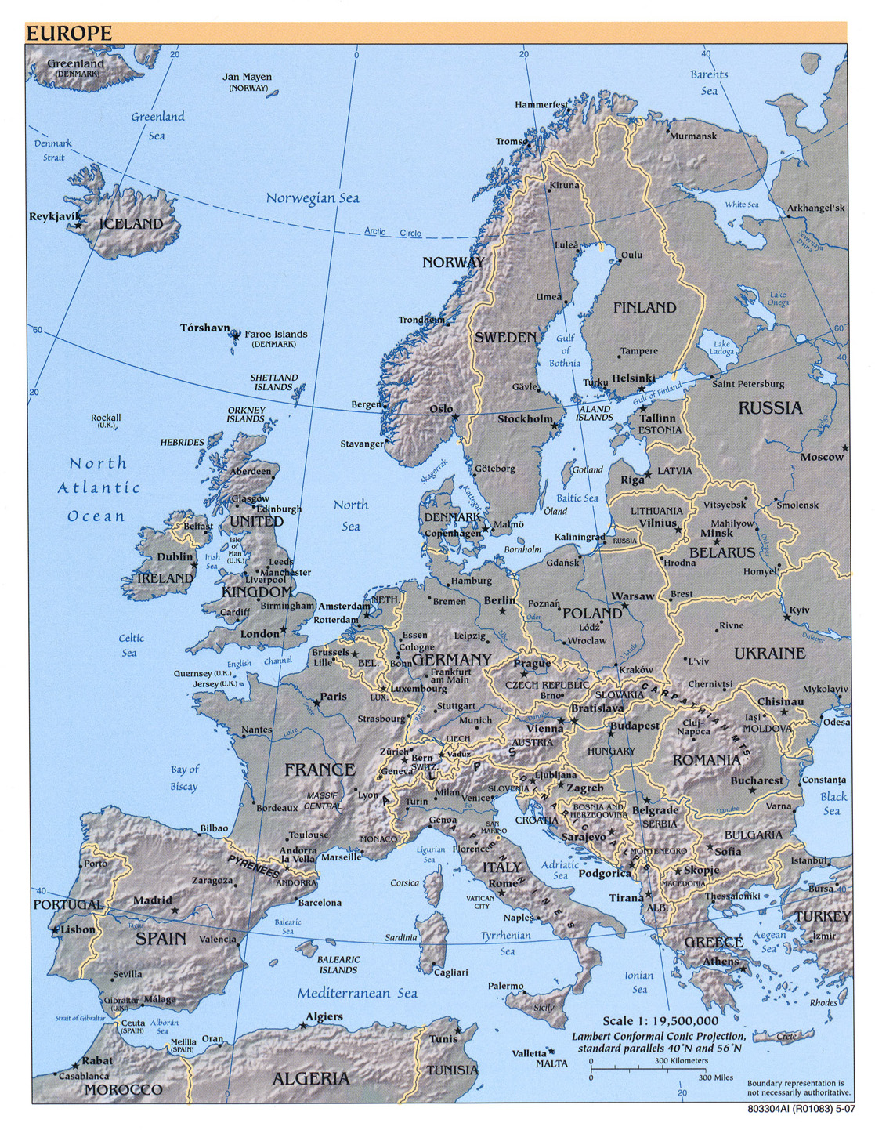
An invitation to the
EFMI STC2011
...When Þór throws Mjöllnir to Zeus and when Freyja smiles to Minerva…
It’s time to think about going South

Slide 2



Ptuj, Slovenia
13 &14 April 2011
E-salus trans confinia sine finibus
E-health across borders without boundaries
EFMI STC2011

Slide 3
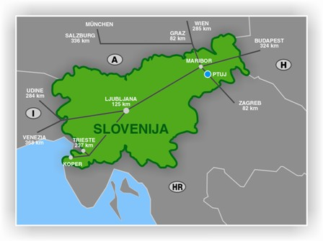

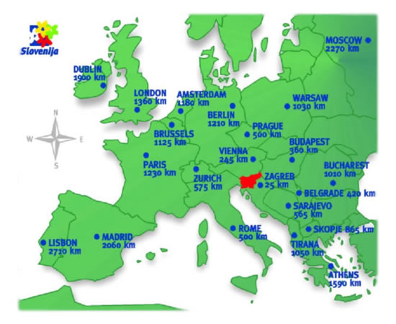

Where is Ptuj?
(Slovenia, Europe)
Vienna 280 km | Budapest 300 km | Munich 511 km | Milano 626 km
Prague 574 km | Rome 850 km | Zurich 823 km | Paris 1300 km

Slide 4
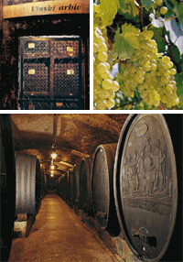
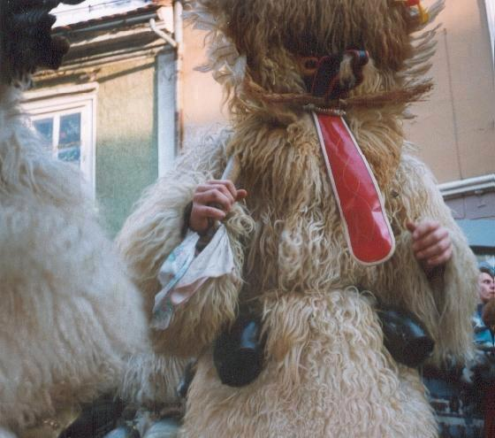
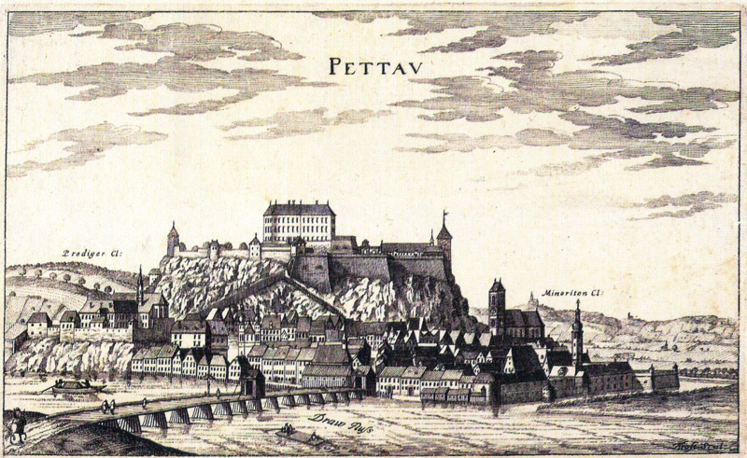

The city of Ptuj
(a historical monument)
Founded in 69 AD by Romans, nearly destroyed by Turks and regained its prosperity ever since
Place of famous carnival, capital of wine growing…

Slide 5
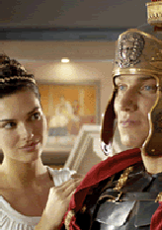
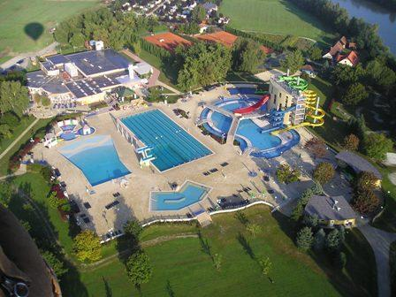

Terme Ptuj
(it’s for work and relax)
First founded in Roman times, later abandoned, and reborn in the sixties of 20th century
Congress and spa center, with almost 500 beds today, conference rooms, social venues…

Slide 6
How to get to Ptuj?
(car, train, bus, plane)
Ptuj lies in the north east of Slovenia, in the Styria (Štajerska) region. Maribor is located 25km away from Ptuj. It takes 45 minutes by to Ptuj from Austria, crossing the border just south (70 km) of Graz.
The distance from Slovenia's capital city, Ljubljana, to Ptuj is 130km. Hungary is 70 km from Ptuj.
Arriving by plane - three airports to choose from: Ljubljana (LJU) in Slovenia, Graz (GRZ) in Austria and Zagreb (ZAG) in Croatia. All three airports have good international connections to all major European cities with regular and "low-cost" carriers.
Arriving by train – all the neighboring countries have train connections to Ptuj
Arriving by car – petrol is one of the cheapest in Europe

Slide 7
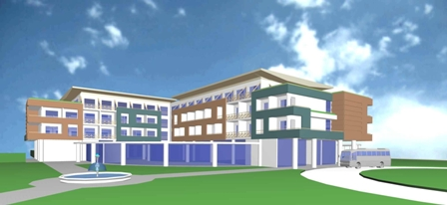

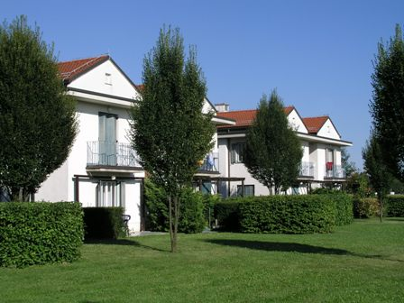

Accomodation at Ptuj
(prices as per 2010)
There are several fine and inexpensive possibilities to overnight in Ptuj and especially at Terme Ptuj
The suggested hotel is the Grand
Hotel Primus where the conference
and all social events will take place.
It has direct access to all the
spa facilities.
Prices (B&B in a double room per person)
  Grand Hotel Primus**** - 63 €
  Bungalows*** Terme Ptuj – 47 €
  Park hotel Ptuj**** - 54 €
  Hotel Mitra Ptuj*** - 39 €

Slide 8
EFMI STC2011
(conference generally)
Title:
  E-salus trans confinia sine finibus
  (E-health across borders without boundaries)
Organization & proposed dates & venue
  SDMI (SIMIA Slovenian Medical Informatics Association)
  13th and 14th of April 2011
  Grand Hotel Primus, Terme Ptuj, Slovenia
Targeted EFMI WGs
  EHR (Electronic Health Record)
  HIIC (Healthcare Informatics for Interregional Cooperation)
  SSE (Safety, Security and Ethics)

Slide 9
EFMI STC2011
Conference themes
Inter-regional health information systems and applications
The patient in cross-border e-Health systems
Language and cultural issues in e-Health system
Legal issues of international e-Health systems
e-Health standardization issues
Assessment of e-Health systems
Safety, security and privacy challenges of e-Health
E-communications in a global community
Cross border education in health informatics

Slide 10

E-salus trans confinia sine finibus
(E-health across borders without boundaries)
Ptuj, Slovenia – 13 &14 April
The geese from Reykjavík fly south to find new places and new life
http://www.stc2011.org
EFMI STC2011

