Slide 1
MIE 2011 Oslo, Norway August 28th to 31st 2011 www.MIE2011.org

Slide 5
August 28th to 31st
MIE2011
Oslo and Akershus
Norwegian Society
for
Medical Informatics

Slide 6
Akershus University Hospital

Slide 7
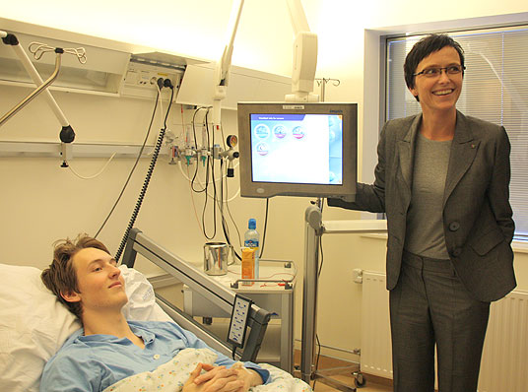

Slide 8
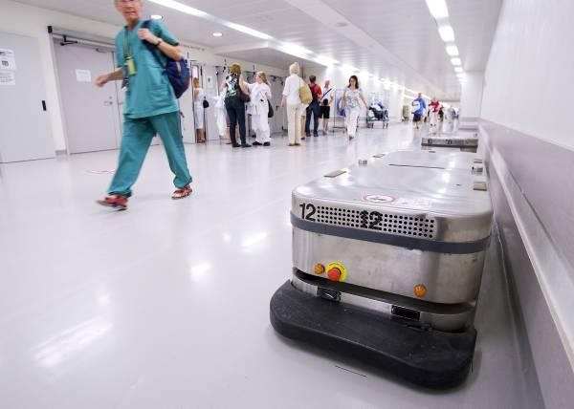
User Centred Networked Health Care

Slide 9
28th to 31st August 2011 Oslo and Akershus www.MIE2011.org
OSLO

Slide 10
Important dates
Pre-registration: 15. June 2010
Submission open: 15. October 2010
Submission deadline: 30. January 2011
Notification: 30. March 2011
Early registration deadline: 15. June 2011

