Slide 1
Procuring interoperability at the expense of usability: A case study of England’s National Programme for IT Assurance Process
Presented to
EFMI STC Iceland
Presented by
Paul Krause & Simon de Lusignan

Slide 2
Abstract:
Background:
Allure of interoperability: improved patient safety & improved efficiency
NHS National Programme for IT improved interoperability – including a “spine”
However, applications hard to use in the clinical environment
Objective:
Explore any plausible causal link between procurement & usability
Method:
Combines Donnabedian & Realistic Review evaluation methods
Review of procurement method
Results:
Procurement processes separate users from developers
Testing against theoretical QA – not in clinical environment
Effective for back office systems – too inflexible for clinical environment
Conclusion:
Agile development techniques should be used
Usability testing should be introduced earlier in the development process

Slide 3
Introduction

Slide 4
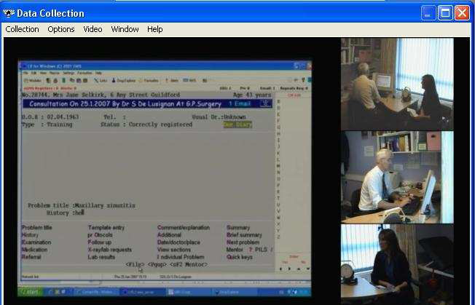
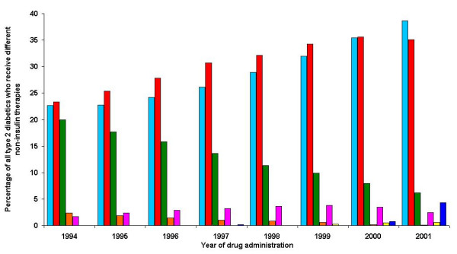
My practice & academic work:
GP in Guildford (30 miles SW of London)
11,800 patient practice
6.5 Whole time equivalent GPs / 8 partners
Computerised since 1988 – EMIS brand since 1994
Involved in “Practice Based Commissioning” and UK’s
First ICO (integrating Care Organisation)
Head of Primary Care, St. Georges, London
Primary Care Informatics (PCI) research group 2 interests:
(1) Impact of IT in the consultation (2) Using routinely collected data for QI
de Lusignan S, Kumarpeli P et al., ALFA open source toolkit.
JMIR 2008 http://www.jmir.org/2008/4/e27/
Lusignan S, Sismanidis C, Carey IM, et al.,. Trends in type 2 diabetes BMC Fam Pract. 2005 Mar 22;6(1):13.

Slide 5
Introduction – use IT at point of care
Clinical records made in real time – in a 10 minute consultation – www.biomedicalinformaitcs .info/alfa/
Sheeler I, Koczan P, Wallage W, de Lusignan S. Low-cost three-channel video for assessment of the clinical consultation. Inform Prim Care. 2007;15(1):25-31.

Slide 6
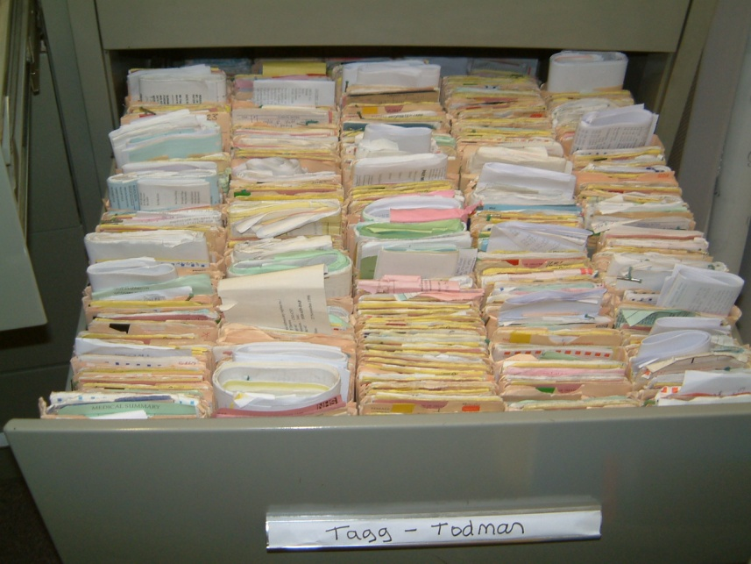
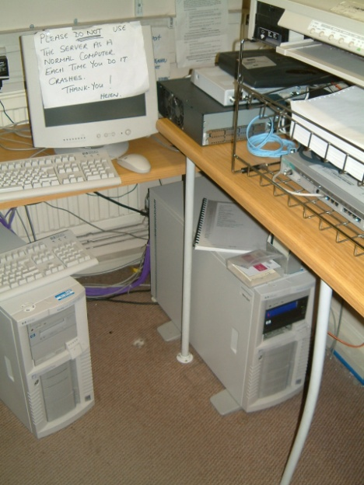
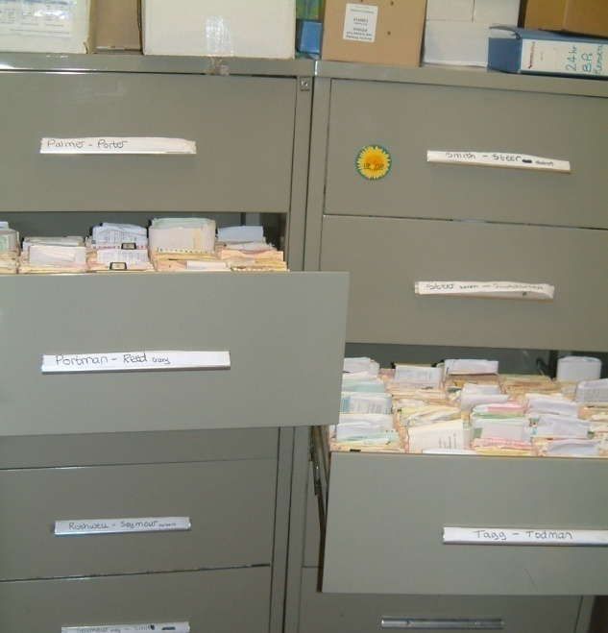
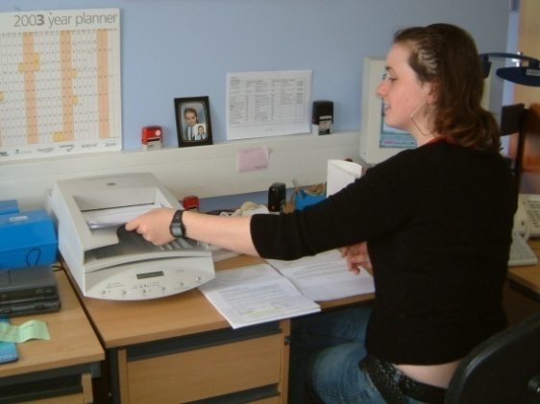
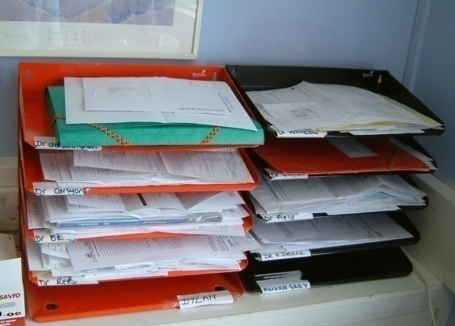
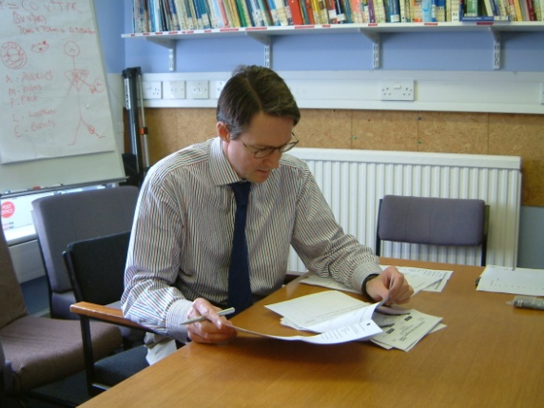
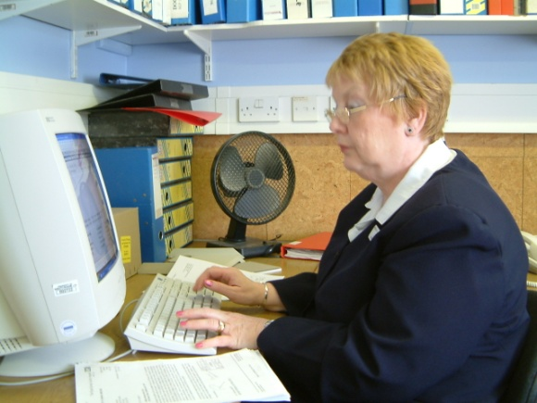
Still scope for improvement - “Paperless” practice !!
Clinical records made in real time – in a 10 minute consultation – always incomplete!
On-site computer hold EPR
Still written records
- First time or new episode?
Scan in post (that arrives)
Post into trays
Mark for coding
Clinical coding

Slide 7
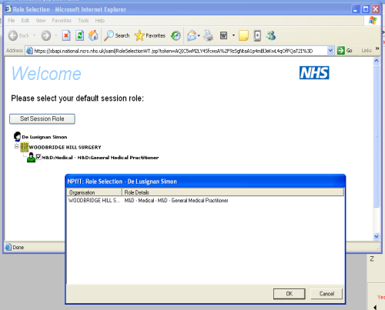
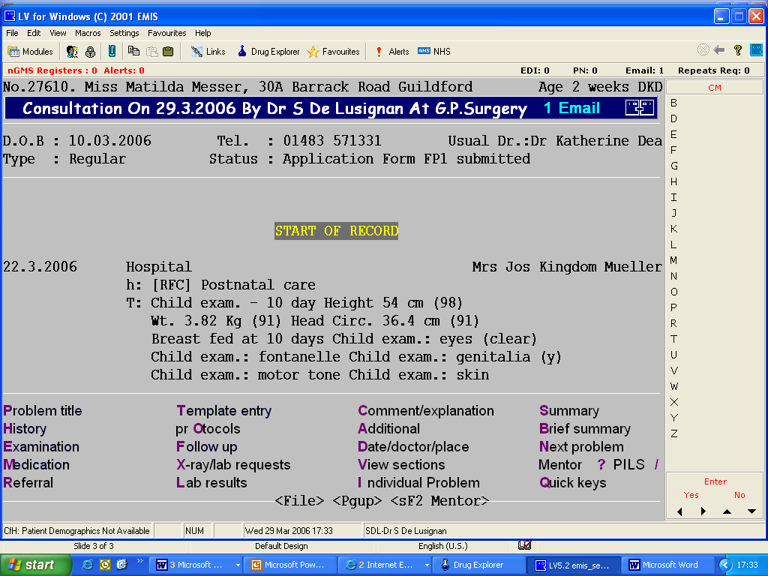
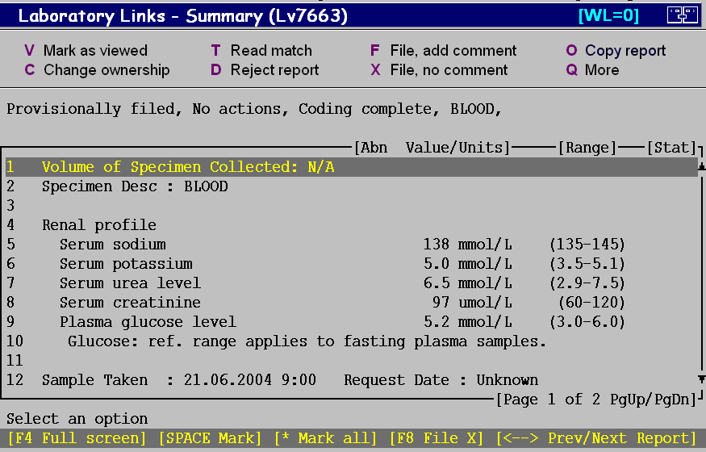
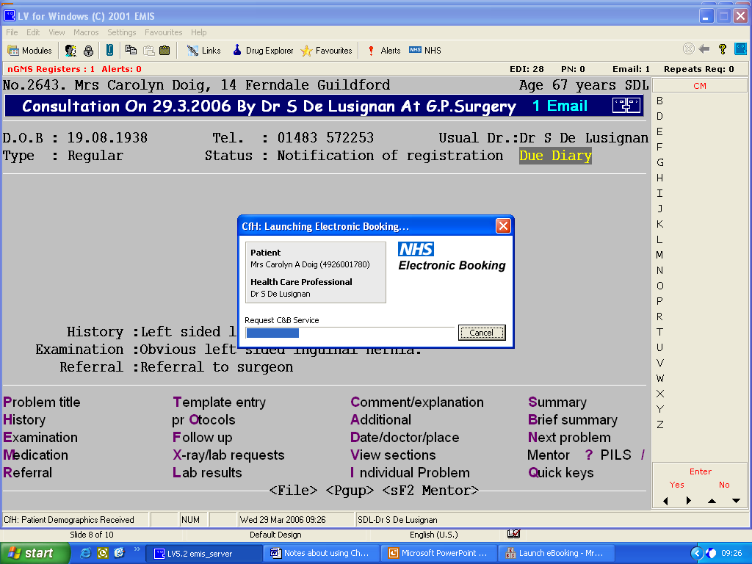
Linked data are now part of everyday UK practice...
Practice EPR
system
Restricted access: Logon + authenticate with a smart card
Patients all have unique IDs
Enables an accurate denominator
On-line lab results posted into system
Example includes serum creatinine
Real time electronic booking
of OPD appointments
Also:
Summary Care Record
ePrescribing – electronic transmission to pharmacy
(3) Some vendors: On-line record access, On-line appointments & Repeat Px

Slide 8
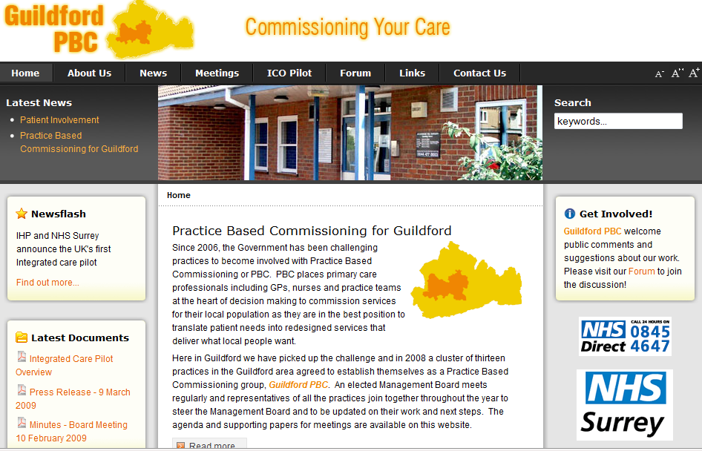
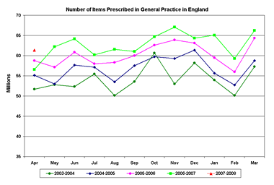
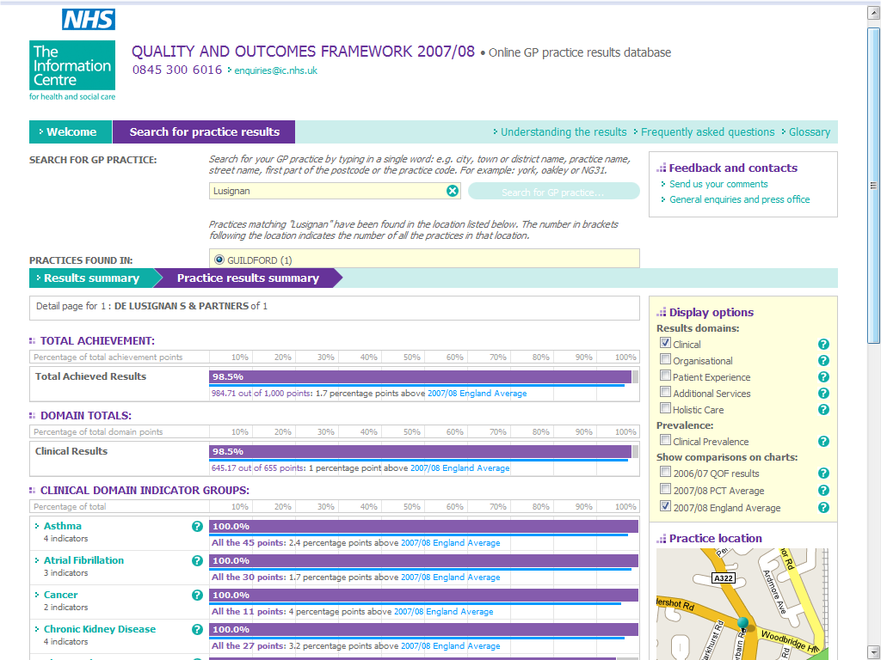
Secondary use of data
Surgery website
woodbridgehillsurgery.co.uk
Share anonymised data locally
www.guildoc.net
Data provided to research data bases
RCGP Spotter practice www.rcgp.org.uk/bru
Q-Research
www.research.org
Ad hoc research projects
Prescribing +
referral data
QOF – Quality based payments
www.ic.nhs.uk
Inspection, appraisal & Re-validation

Slide 9
BACKGROUND

Slide 10
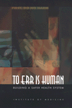
EMR systems should reduce medical errors
Two key publications highlighted problems with patients safety
- 44 – 98,000 preventable medical deaths (USA)
To Err is Human (IOM 1999)
The potential role of informatics – To provide a shared EPR…
Need a National Health Information infrastructure
Crossing the quality chasm (IOM 2001)
Following these reports many countries have invested in health IT infrastructure hoping to improve patient safety + improve the efficiency of their healthcare systems
de Lusignan S, Teasdale S. Achieving benefit for patients in primary care informatics: the report of a international consensus workshop at Medinfo 2007. Inform Prim Care. 2007;15(4):255-61.

Slide 11
Summary
UK general practice has been computerised since the 1990s + now it is given further impetus by:
Linkage of GP computer systems to other parts of the NHS
Financial subsidies for initial purchase – now computers are NHS funded
“The worlds largest IT project” – the National Programme for IT (NPfIT)
Financially incentivised quality targets – based only on computer records
This presentation explores the procurement process & its impact
de Lusignan S, Teasdale S, Little D, Zapp J, Zuckerman A, Bates DW, Steele A. Comprehensive computerised primary care records are an essential component of any national health information strategy: report from an international consensus conference. Inform Prim Care. 2004;12(4):255-64.

Slide 12
Method

Slide 13
Method:
Document review
Common Assurance
Process - CAP

Slide 14
Results

Slide 15
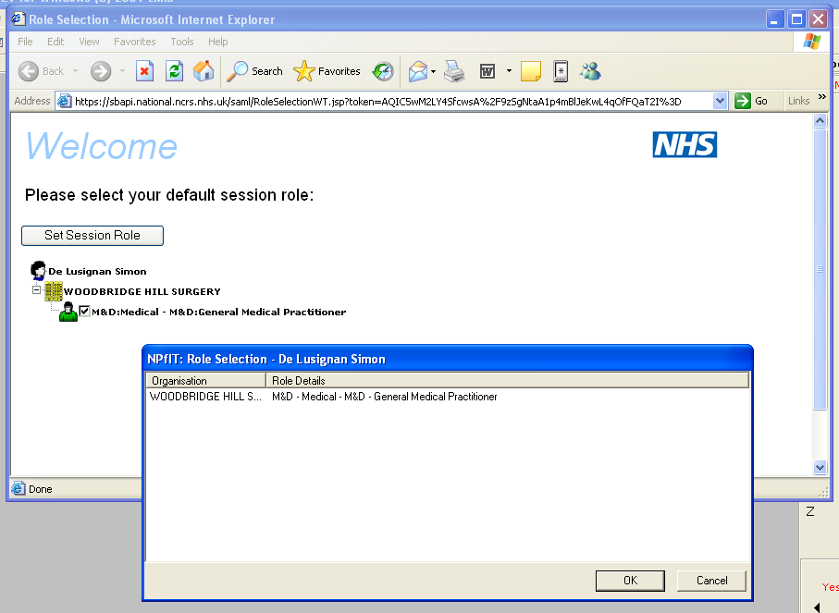
Examples of national programmes linking to desktop EPR systems
Logon + authenticate + smart card
Patients on national demographic service
On-line lab results posted into system
Choose + Book for referral

Slide 16
On-line GP quality scores http://www.qof.ic.nhs.uk/

Slide 18
Results - Back office “Successes”
Structure Input | Process Context | Utility | Implications
Authenticate users | Much longer to log on | Clumsy system mean smart cards left in one machine | - - Use system where staff can be mobile
Electronic record transfer “GP2GP” | Shock! Who wrote that narrative! | Will greatly improve data quality | +++
National demographic service | Any mismatches added to workflow | Much more accurate denominator | +++++

Slide 19
Results - Clinical failures?
Structure Input | Process Context | Utility | Implications
Summary care record + online “My health space” | Poor organisational fit | No positive influence | - - On-line records Un-researched niche?
On-line clinic booking | Impossible to include in workflow | Does not use national codes | - - Redesign
On-line performance data | No effect apparent Distorts record | Unsure | + / -
Lab-tests results on-line | Less social process Rapid access to rest of record | Vastly increased capacity for QI, Audit + Research | ++++++

Slide 20
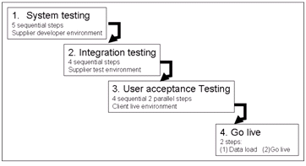
Analysis of Common Assurance Process (CAP):
CAP Process – sequential
Essentially “Waterfall” in nature
Stage managers responsible to people in steps before & after
User acceptance is too late in process
Remote from users

Slide 21
Discussion

Slide 22
Discussion:
National Programme for IT has focussed much resource & effort on interoperable systems
The process has been burdensome for vendors
Clinical systems in primary care have improved functionality very little over this period
Vendors attention has been on meeting National Programme requirements
Our analysis is that the procurement system is a fundamental flaw
There has been insufficient focus on usability
Fixed user requirements are an illusory concept
Choose and book, the summary care record and the on-line health records are exemplars
Waterfall methods are inappropriate for much application development
Usability needs to be given greater prominence
Agile systems of development may be much better suited to developing clinical systems

Slide 23
Conclusions
Development of electronic patient record systems for needs to be driven by the required outcome/use of the records.
Usability of record systems in the clinical setting needs to be given much greater prominence

Slide 24
The End!
Acknowledgements
Paul Krause (co-author)
Professor of software engineering Surrey University
Thanks for listening...
Simon de Lusignan
slusigna@sgul.ac.uk

